Slide 1
Relational Algebra

Slide 2
Relational Query Languages
Languages for describing queries on a relational database
Structured Query Language (SQL)
Predominant application level query language
Declarative
Relational Algebra
Intermediate language used within DBMS
Procedural

Slide 3
What is an “Algebra”
Mathematical system consisting of:
Operands --- variables or values from which new values can be constructed.
Operators --- symbols denoting procedures that construct new values from given values.

Slide 4
What is Relational Algebra?
An algebra whose operands are relations or variables that represent relations.
Operators are designed to do the most common things that we need to do with relations in a database.
The result is an algebra that can be used as a query language for relations.

Slide 5
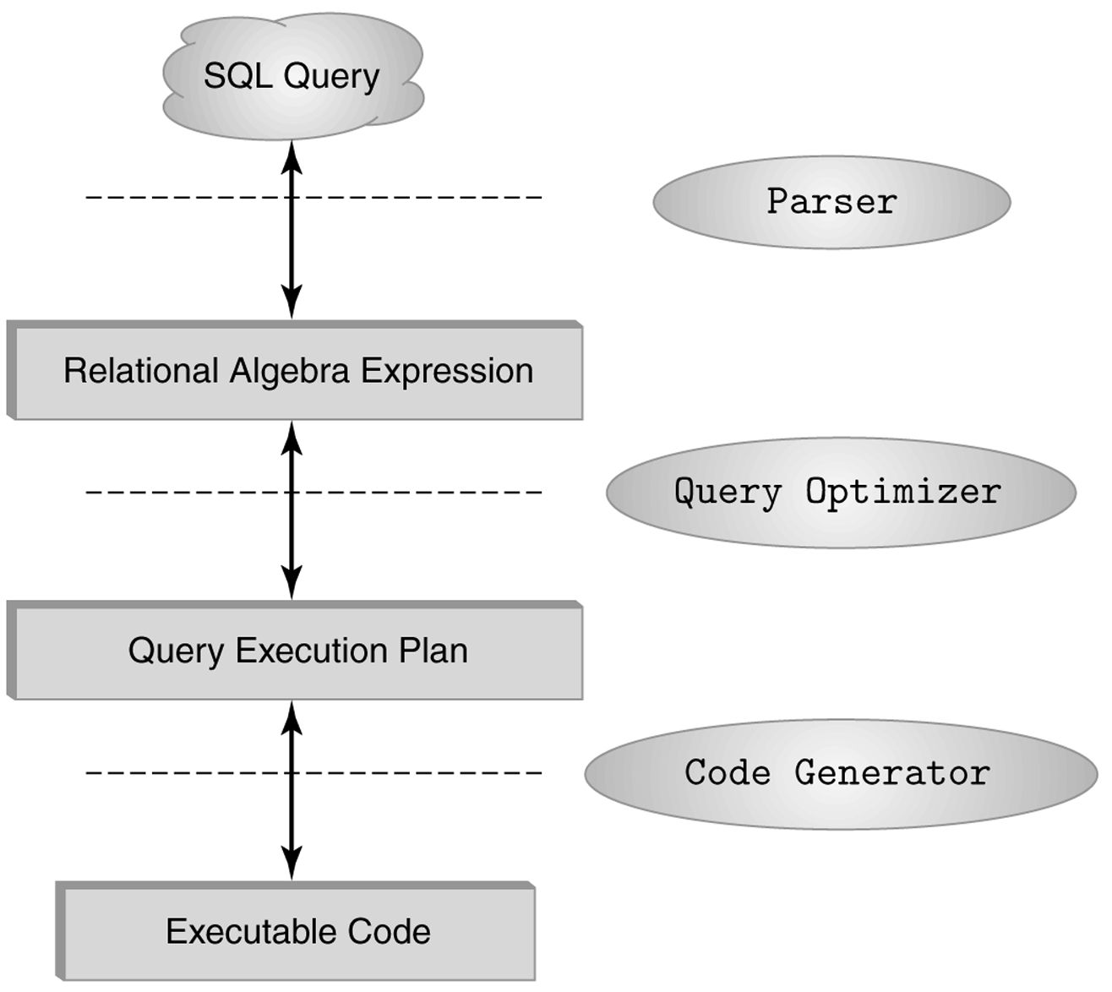
The Role of Relational Algebra in a DBMS

Slide 6
Relational Algebra and SQL
6 primitive operators: union, difference, product, projection, selection and renaming.
Also: derived operators (operators in arithmetic, such as square(x) = x * x). Examples include intersection and join.

Slide 7
Relational Algebra
Basic operations:
Selection ( ) Selects a subset of rows from relation (horizontal).
Projection ( ) Deletes unwanted columns from relation(vertical).
Cross-product ( ) Allows us to combine two relations.
Set-difference ( ) Tuples in relation 1 but not in relation 2.
Union ( ) Tuples in relation 1 and in relation 2
Rename (ρ) renames attribute(s) and relation
Additional operations:
Intersection, join, division, renaming.
Notes:
6

Slide 8
Project Operator
Produces table containing subset of columns of argument table
π_{attribute list}(relation)
Example:
Person π_{Name,Hobby}(Person)
Id Name Address Hobby Name Hobby
1123 John 123 Main stamps
1123 John 123 Main coins
5556 Mary 7 Lake Dr hiking
9876 Bart 5 Pine St stamps
John stamps
John coins
Mary hiking
Bart stamps

Slide 9
Example:
Person π_{Name,Address}(Person)
Id Name Address Hobby
Name Address
1123 John 123 Main stamps
1123 John 123 Main coins
5556 Mary 7 Lake Dr hiking
9876 Bart 5 Pine St stamps
John 123 Main
Mary 7 Lake Dr
Bart 5 Pine St
Result is a table (no duplicates); can have fewer tuples
than the original

Slide 10
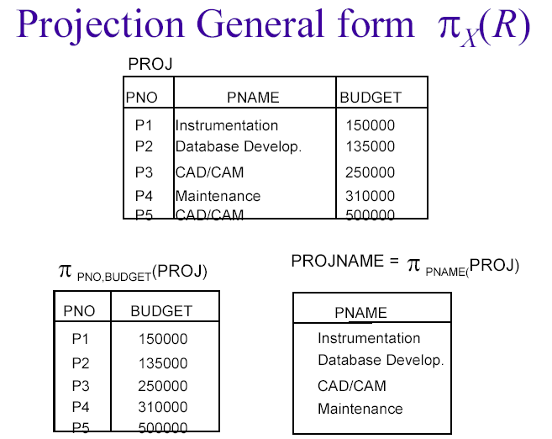

Slide 11
Selection (σ)
Selects rows that satisfy selection condition.
Result is a relation.
Schema of result is same as that of the input relation.
Do we need to do duplicate elimination?

Slide 12
Expressions
π _{Id, Name} (σ Hobby=’stamps’ OR Hobby=’coins’ (Person) )
Id Name Address Hobby
Id Name
1123 John 123 Main stamps
1123 John 123 Main coins
5556 Mary 7 Lake Dr hiking
9876 Bart 5 Pine St stamps
1123 John
9876 Bart
Result
Person

Slide 13
Set Operators
Relation is a set of tuples, so set operations should apply: ∩, ∪, − (set difference)
Result of combining two relations with a set operator is a relation => all its elements must be tuples having same structure
Hence, scope of set operations limited to union compatible relations

Slide 14
Union Compatible Relations
Two relations are union compatible if
Both have same number of columns
Names of attributes are the same in both
Attributes with the same name in both relations have the same domain
Union compatible relations can be combined using union, intersection, and set difference

Slide 15
Example
Tables:
Person (SSN, Name, Address, Hobby)
Professor (Id, Name, Office, Phone)
are not union compatible.
But
π _{Name} (Person) and π _{Name} (Professor)
are union compatible so
π _{Name} (Person) - π _{Name} (Professor)
makes sense.

Slide 16
Union
Union A ∪ B
Use SQL keyword UNION. Tables must be compatible ... have the same attributes (column headings).
(SELECT artist FROM Pop_albums
WHERE artist LIKE 'U%')
UNION
(SELECT artist FROM Band_members
WHERE member = 'Grohl');
Result is a one column table containing three entries: Foo Fighters, U2 and Underworld.

Slide 17
Union
S1
S2

Slide 18
Set Difference
S1
S2 – S1
S2

Slide 19
Intersection
Intersection takes two input relations, which must be union-compatible.
R ∩ S = R − (R − S)

Slide 20
Intersection
Intersection A ∩ B
Use SQL keyword INTERSECT. Tables must be compatible.
Query :
(SELECT artist FROM Pop_albums)
INTERSECT
(SELECT artist FROM Band_members);

Slide 21
Intersection
S1
S2

Slide 22
Renaming(ρ)
The RENAME operator gives a new schema to a relation.
R1 := RENAME_{R1(A1,…,An)}(R2) makes R1 be a relation with attributes A1,…,An and the same tuples as R2.
Simplified notation: R1(A1,…,An) := R2.

Slide 23
Example
Bars name, addr
Joe’s Maple St.
Sue’s River Rd.
R(bar, addr) := Bars
R bar addr
Joe’s Maple St.
Sue’s River Rd.

Slide 24
Cross-Product
S1 x R1: Each row of S1 paired with each row of R1.
Q: How many rows in the result?
Result schema has one field per field of S1 and R1, with field names `inherited’ if possible.
May have a naming conflict: Both S1 and R1 have a field with the same name.
In this case, can use the renaming operator:

Slide 25
Cross Product Example
R1
S1
R1 X S1 =

Slide 26
Compound Operator: Join
Joins are compound operators involving cross product, selection, and (sometimes) projection.
Most common type of join is a “natural join” (often just called “join”). R S conceptually is:
Compute R X S
Select rows where attributes that appear in both relations have equal values
Project all unique attributes and one copy of each of the common ones.

Slide 27
Natural Join Example
R1
S1
R1 S1 =

Slide 28
Other Types of Joins
Condition Join (or “theta-join”):
Result schema same as that of cross-product.
May have fewer tuples than cross-product.
Equi-Join: Special case: condition c contains only conjunction of equalities.
Self Join

Slide 29
“Theta” Join Example
R1
S1
=

Slide 30
Outer Join
An extension of the join operation that avoids loss of information.
Computes the join and then adds tuples form one relation that does not match tuples in the other relation to the result of the join.
Uses null values:
null signifies that the value is unknown or does not exist
All comparisons involving null are (roughly speaking) false by definition.

Slide 31
Outer Join – Example
Relation loan
loan-number
branch-name
amount
L-170
L-230
L-260
Downtown
Redwood
Perryridge
3000
4000
1700
Relation borrower
customer-name
loan-number
Jones
Smith
Hayes
L-170
L-230
L-155

Slide 32
Left Outer Join
loan Borrower
loan-number
branch-name
amount
customer-name
L-170
L-230
L-260
Downtown
Redwood
Perryridge
3000
4000
1700
Jones
Smith
null

Slide 33
Right Outer Join
loan borrower
loan-number
branch-name
amount
customer-name
L-170
L-230
L-155
Downtown
Redwood
null
3000
4000
null
Jones
Smith
Hayes
Full Outer Join
Loan borrower
loan-number
branch-name
amount
customer-name
L-170
L-230
L-260
L-155
Downtown
Redwood
Perryridge
null
3000
4000
1700
null
Jones
Smith
null
Hayes

Slide 34
Compound Operator: Division
Goal: Produce the tuples in one relation, R that match all tuples in another relation, S.
For a tuple t to appear in the result T of the DIVISION, the values in t must appear in R in combination with every tuple in S.
Useful for expressing “for all” queries like: Find s.ids of sailors who have reserved all boats.

Slide 35
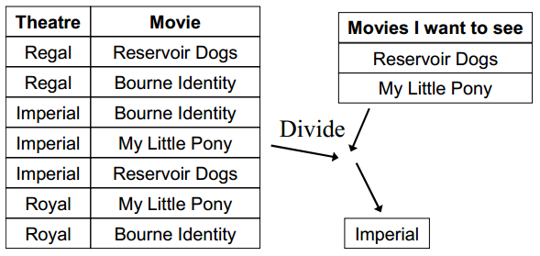
Division cont.
Takes two relations, one binary and one unary, and returns a relation consisting of all values of one attribute of the binary relation that match (in the other attribute) all values in the unary relation.

Slide 36
Examples of Division A/B
B1
B2
B3
A
A/B1
A/B2
A/B3

Slide 37
Division - Example
List the Ids of students who have passed all courses that were taught in spring 2000
Numerator:
StudId and CrsCode for every course passed by every student:
Course π_{StudId, CrsCode} (σ_{Grade≠ ‘F’} (Transcript) )
Denominator:
CrsCode of all courses taught in spring 2000
Spring π_{CrsCode} (σ_{Semester=‘S2000’} (Teaching) )
Result is numerator/denominator
Result Course ÷ Spring

Slide 38
Example Queries
Find all customers who have an account at all branches located in Brooklyn city.
∏_{customer-name, branch-name} (depositor account) ÷ ∏_{branch-name} (σ_{branch-city = “Brooklyn”} (branch))

Slide 39
Modification of the Database
The content of the database may be modified using the following operations:
Deletion
Insertion
Updating
All these operations are expressed using the assignment operator.

Slide 40
Deletion
A delete request is expressed similarly to a query, except instead of displaying tuples to the user, the selected tuples are removed from the database.
Can delete only whole tuples; cannot delete values on only particular attributes
A deletion is expressed in relational algebra by:
r ← r – E
where r is a relation and E is a relational algebra query.

Slide 41
Deletion Examples
Delete all account records in the Perryridge branch.
account ← account – σ _{branch-name = “Perryridge”} (account)
Delete all loan records with amount in the range of 0 to 50
loan ← loan – σ _{amount ≥ 0 and amount ≤ 50} (loan)

Slide 42
Insertion
To insert data into a relation, we either:
specify a tuple to be inserted
write a query whose result is a set of tuples to be inserted
in relational algebra, an insertion is expressed by:
r ← r ∪ E
where r is a relation and E is a relational algebra expression.
The insertion of a single tuple is expressed by letting E be a constant relation containing one tuple.

Slide 43
Insertion Examples
Insert information in the database specifying that Smith has $1200 in account A-973 at the Perryridge branch.
account ← account ∪ {(“Perryridge”, A-973, 1200)}
depositor ← depositor ∪ {(“Smith”, A-973)}

Slide 44
Updating
A mechanism to change a value in a tuple without changing all values in the tuple
Use the generalized projection operator to do this task
r ← ∏ _{F1, F2, …, FI,} (r)

Slide 45
Update Examples
Make interest payments by increasing all balances by 5 percent.
account ← ∏ _{AN, BN, BAL * 1.05} (account)
where AN, BN and BAL stand for account-number, branch-name and balance, respectively.
Pay all accounts with balances over $10,000, 6 percent interest and pay all others 5 percent
account ← ∏ _{AN, BN, BAL * 1.06} (σ _{BAL > 10000} (account)) ∪ ∏_{AN, BN, BAL * 1.05} (σ_{BAL ≤ 10000} (account))

Slide 46
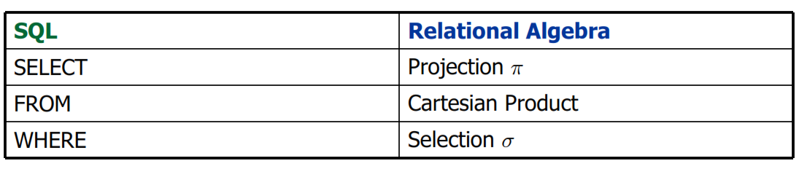
SQL VS RELATIONAL ALGEBRA

Slide 47
Questions:
Q1. FACULTY(name, dpt, salary)
CHAIR(dpt, name)
Find the salaries of department chairs using RA and SQL.
RA:
SQL: SELECT FACULTY.dpt, FACULTY.salary
FROM FACULTY, CHAIR
WHERE FACULTY.name = CHAIR.name AND
FACULTY.dpt = CHAIR.dpt

Slide 48
Boats
Reserves
Sailors
Find names of sailors who’ve reserved boat id 103
Solution 1:
Solution 2:

Slide 49
Find names of sailors who’ve reserved a red boat
Information about boat color only available in Boats; so need an extra join:

Slide 50
works(person name, company name, salary);
lives(person name, street, city);
located in(company name, city);
managers(person name, manager name);
Find the names of the persons who work for company ’FBC’.
RA:
SQL: Select person_name From works
Where company_name = ’FBC’

Slide 51
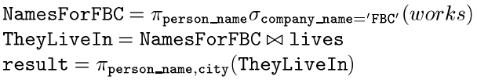
works(person name, company name, salary);
lives(person name, street, city);
located in(company name, city);
managers(person name, manager name);
List the names of the persons who work for company ’FBC’ along with the cities they live in.
RA:
SQL: Select lives.person_name, city
From works, lives
Where company_name = ’FBC’ and
works.person_name = lives.person_name

Slide 52

works(person-name, company name, salary);
lives(person-name, street, city);
located in(company-name, city);
managers(person-name, manager name);
Find the names of the persons who live and work in the same city.
RA:
SQL:
Select person_name
From works, lives, locatedin
Where works.person-name =lives.person-name
and works.company name=located_in.company-name
and located_in.city = lives.city

Slide 53
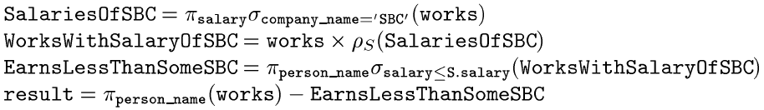
works(person-name, company name, salary);
lives(person-name, street, city);
located in(company-name, city);
managers(person-name, manager name);
Find the persons whose salaries are more than the salary of everybody who work for company ’SBC’.
RA:
SQL:
Select person_name
From works
Where salary > all (Select salary
From works
Where Company_name = ’SBC’)

Slide 54
